Slide 1
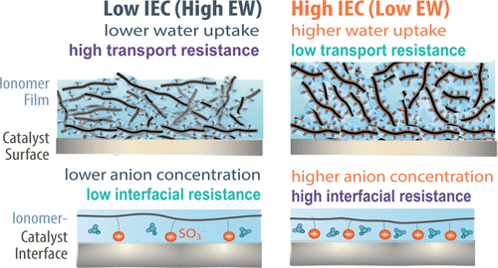
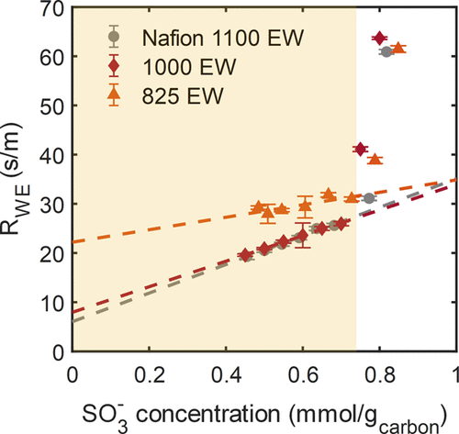
Linking Perfluorosulfonic Acid (PFSA) Ionomer Chemistry and High-Current Density Performance in Fuel-Cell Electrodes
Examined the electrode gas-transport resistance and its components as a function of ionomer content & chemistry
Low-equivalent-weight ionomers provide better transport (more water) but also higher interfacial resistance due to the high density of sulfonic-acid moeities
Electrode materials optimized for one reactant species transport may inhibit other transport processes. This work explores such trade-offs, where ionomer films provide conductivity but retard oxygen transport to the Pt reaction site; and cause interfacial resistance due to sulfonate/Pt interactions.
The effects of equivalent weight are also observed via in situ ionic conductivity and CO displacement measurements.
CL performance results are supported by ex-situ data of model thin films, thereby providing direct linkages and applicability of model studies to probe complex heterogeneous structures.
R_{WE} vs. SO₃– loading per unit carbon weight.
With an increasing I/C ratio, sulfonate–anion loading per unit carbon wt increases linearly
Structural and resultant CL performance changes occur above a threshold sulfonic-group loading, highlighting the significance of ink-based interactions
Evidence for direct linkages between CL performance and ex-situ properties of model ionomer thin films on Pt support
A. Chowdhury, A. Bird, J. Liu, I. Zenyuk, A. Kusoglu, C.J. Radke, and A.Z. Weber, ACS Applied Materials and Interfaces,36 (2021), 42579–42589 | UC Berkeley, UCI, LBNL
Notes:
https://pubs.acs.org/doi/10.1021/acsami.1c07611

